Slide 1
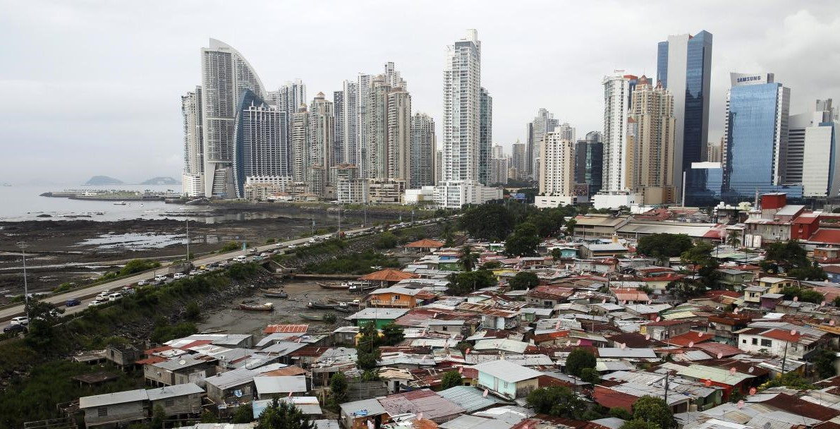

Health Inequality and Public Policy
(2)
What is health inequality?
Monday, 22. September 2025
Ass.-Prof. Dr. David Weisstanner
Faculty of Health Sciences and Medicine
University of Lucerne

Slide 2

BSc thesis by
Abisha Baskaran

Slide 3
Two key definitions
Health inequities
The unfair and avoidable or remediable systematic differences in health among population groups defined socially, economically, demographically or geographically. Health inequities arise fundamentally from the unequal allocation of power, money and resources, which manifest in the unequal distribution of social determinants.
Health inequalities (USA: disparities)
The observable differences in health between population groups. Health inequality is the metric by which health inequity can be assessed, meaning characteristics that stratify people’s power and access to opportunities should most closely reflect likely areas of unfair health differences.

Slide 4
Two key definitions
Health inequities
The unfair and avoidable or remediable systematic differences in health among population groups defined socially, economically, demographically or geographically. Health inequities arise fundamentally from the unequal allocation of power, money and resources, which manifest in the unequal distribution of social determinants.
Health inequalities (USA: disparities)
The observable differences in health between population groups. Health inequality is the metric by which health inequity can be assessed, meaning characteristics that stratify people’s power and access to opportunities should most closely reflect likely areas of unfair health differences.

Slide 5
Two key definitions
Accurate?
Health inequities
The unfair and avoidable or remediable systematic differences in health among population groups defined socially, economically, demographically or geographically. Health inequities arise fundamentally from the unequal allocation of power, money and resources, which manifest in the unequal distribution of social determinants.
Health inequalities (USA: disparities)
The observable differences in health between population groups. Health inequality is the metric by which health inequity can be assessed, meaning characteristics that stratify people’s power and access to opportunities should most closely reflect likely areas of unfair health differences.
Which definition do you find more convincing, and why?
Notes:
2 additions (Braveman 2025):
In the US, «health disparities» is much more common than «health inequality» which is more common elsewhere.
«Health inequalities» does not mean absence of normative concern

Slide 6
Definition of health equity in switzerland
Swiss Federal Office of Public Health (FOPH):
“Ensuring health equity means ensuring that everyone has equal opportunities to develop, maintain and if necessary restore their health.”
  («Gesundheitliche Chancengleichheit bedeutet, dass alle die gleichen Möglichkeiten zur Entwicklung, Erhaltung und falls nötig Wiederherstellung ihrer Gesundheit haben.»)
“The promotion of health equity and equitable access to healthcare are guiding principles of Switzerland’s health and integration policy. Through its activities, the FOPH also aims to enhance quality and efficiency in the healthcare system.”
Contrast the FOPH’s definition with the WHO definitions on health inequities and health inequalities:
Similarities?
Differences?
Notes:
More accurate term: health equality of opportunity
Braveman 2025: «Equity means justice». This FOPH definition does not fulfil this criterion.

Slide 7
Measuring Health inequality – Asada’s experiment
Scenario: Imagine two equal groups (e.g. men and women). Their life expectancy starts at 20 and 30. Everyone then takes one of two pills:
The red pill adds the same number of years to both groups.
The blue pill multiplies life expectancy by the same proportion for both groups.
Both pills raise average life expectancy by the same amount (+25).
But how does health inequality change…
…with the red pill?
…with the blue pill?
Notes:
With the red pill the absolute gap stays 10 while the relative ratio gets smaller.
With the blue pill the relative ratio stays the same while the absolute gap gets bigger.

Slide 8
Absolute and relative “gap” measures
Rate Difference (RD): y1 – y2
where 𝑦1 is the health status of the least healthy group and 𝑦2 is the health status of the
most healthy.
More complex version (regression-based): Slope Index of Inequality
Rate Ratio (RR): y1 / y2
where 𝑦1 is the health status of the least healthy group and 𝑦2 is the health status of the
most healthy.
More complex version (regression-based): Relative Index of Inequality

Slide 9
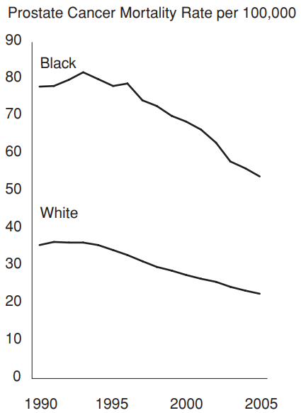
Exercise: Absolute and relative health inequalities
(1) Calculate the rate difference and the rate ratio in prostate cancer mortality between Black and White men in 1990 and 2005.
(2) How do you evaluate the observed trend in health inequality between 1990 and 2005?
Trends in Age-Adjusted Prostate Cancer Mortality among Black and White Males in the US, 1990-2005
78
78
54
54
36
36
23
23
Source: Harper et al. (2010)

Slide 10
Health gaps vs. gradients
“The social gradient in health: This means people and communities have progressively better health, the higher their socioeconomic position or conditions” (WHO 2025)
Notes:
Not adjusted by age, gender, etc. – maybe then a bit smaller differences

Slide 11
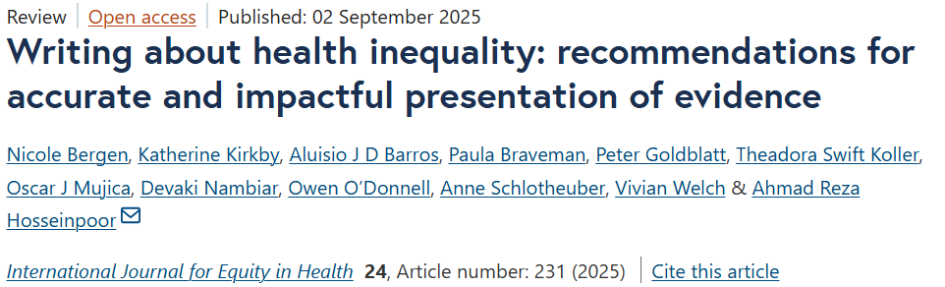
Implications for writing about health inequalit
Recommendation 1: Use terminology deliberately and consistently
  Health inequality vs health inequity; dimensions of inequality; sex/gender; race/ethnicity
Recommendation 2: Present statistical content accurately and with sufficient detail
  Units of measurement (absolute vs relative; percentage vs percentage point); association vs causation
Recommendation 3: Adhere to reporting guidelines and best practices
  Report both absolute and relative measures, average values, (sub)groups size, etc.
Recommendation 4: Respect and uphold the interests of affected communities through inclusive writing practices
  Affirming / strength-based language, co-writing with communities represented in research where possible

Slide 12
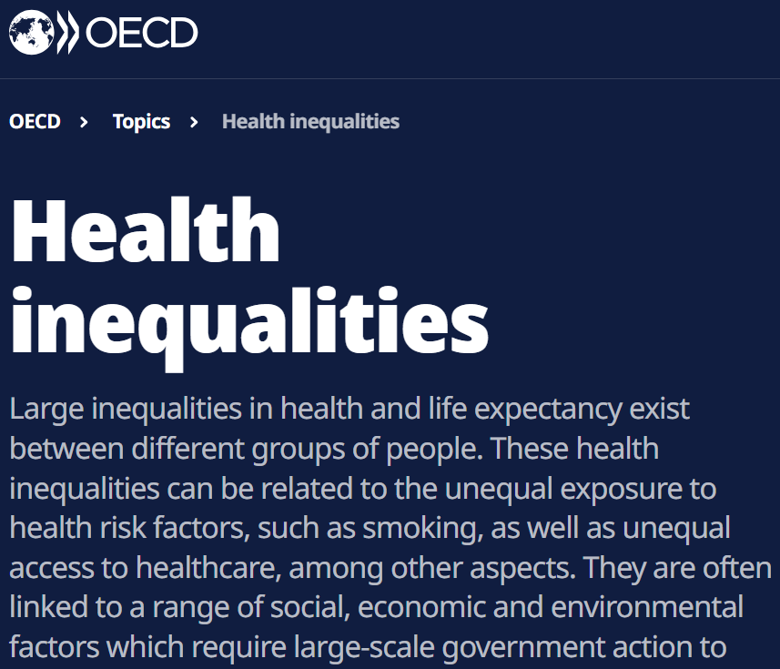
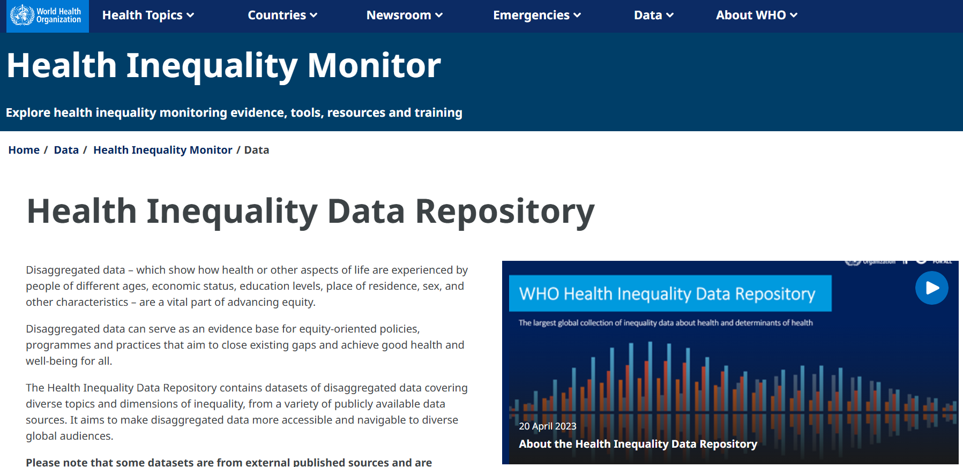

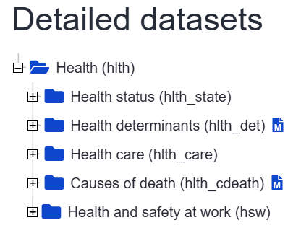
Data sources - international
https://www.oecd.org/en/topics/sub-issues/health-inequalities.html
https://ec.europa.eu/eurostat/web/health/database
https://www.who.int/data/inequality-monitor/data

Slide 13
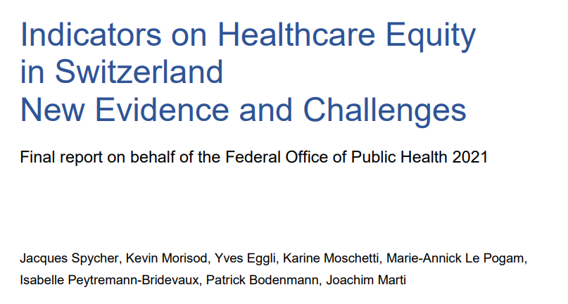

Data sources - switzerland
https://www.obsan.admin.ch/de/publikationen/2023-gesundheitliche-chancengleichheit-datenquellen
bag.admin.ch/dam/de/sd-web/eJzz0Ebd9ndr/report-indicators-on-healthcare-equity.pdf

Slide 14
Application – recap week 1
Milestone week 1: Getting started, loading the ISSP/ESS datasets
  R/Stata code on Moodle
  Questions, tips, difficulties?

Slide 15
Application week 2 – first decriptive indicators
Milestone today: First basic descriptive health inequality indicators in the ISSP/ESS
  Task 1: Find/choose a suitable outcome measure (e.g. subjective health status, depression, etc.)
  Task 2: Create a health gap measure
      Gap between two groups: Rate difference and rate ratio
      Use a categorical group measure: men vs women, high vs low education, urban vs rural, migrant vs non-migrant background, etc.
  Task 3: Create a plot that shows a health gradient
      Use a continuous/ordinal measure: for example, income, financial difficulties in family when growing up, subjective social status, etc.

Slide 16
Outlook next week
3 29.09.2025 Explanations of health inequality
Reading: Bartley, M., & Kelly-Irving, M. (2025). Health Inequality. An Introduction to Concepts, Theories and Methods (3rd ed.). Polity Press.
Chapter 4 “Explanatory Models I: Behavioural Explanations”, pp. 75-93,
Chapter 5 “Explanatory Models II: Material Explanations”, pp. 94-110,
Chapter 6 “Explanatory Models III: Psychosocioal Factors”, pp. 111-126.
Applied focus: Finding items to analyse behavioural, material, psychosocial explanations in the ISSP/ESS

Slide 17
References
Asada, Y. (2010). On the choice of absolute or relative inequality measures. The Milbank Quarterly, 88(4), 616–622; discussion 623-627. https://doi.org/10.1111/j.1468-0009.2010.00614.x
Bergen, N., Kirkby, K., Barros, A. J. D., Braveman, P., Goldblatt, P., Koller, T. S., Mujica, O. J., Nambiar, D., O’Donnell, O., Schlotheuber, A., Welch, V., & Hosseinpoor, A. R. (2025). Writing about health inequality: Recommendations for accurate and impactful presentation of evidence. International Journal for Equity in Health, 24(1), 231. https://doi.org/10.1186/s12939-025-02548-6
Braveman, P. (2025). Health Inequalities, Disparities, Equity: What’s in a Name? American Journal of Public Health, 115(7), 996–1002. https://doi.org/10.2105/AJPH.2025.308062
Harper, S., King, N. B., Meersman, S. C., Reichman, M. E., Breen, N., & Lynch, J. (2010). Implicit value judgments in the measurement of health inequalities. The Milbank Quarterly, 88(1), 4–29. https://doi.org/10.1111/j.1468-0009.2010.00587.x
Mackenbach, J. P. (2019). Health Inequalities. Persistence and Change in European Welfare States. Oxford University Press.
McCartney, G., Popham, F., McMaster, R., & Cumbers, A. (2019). Defining health and health inequalities. Special Issue on Migration, Ethnicity, Race and Health, 172, 22–30. https://doi.org/10.1016/j.puhe.2019.03.023
Spycher, J., Morisod, K., Eggli, Y., Moschetti, K., Pogam, M.-A. L., Peytremann-Bridevaux, I., Bodenmann, P., & Marti, J. (2021). Indicators on Healthcare Equity in Switzerland. New Evidence and Challenges. Report commissioned by the Federal Office of Public Health. FOPH.
WHO. (2025, May 6). World report on social determinants of health equity. https://www.who.int/publications/i/item/9789240107588

